Slide 1
MODELLING HAZARD POINTERS
LECTURER:
Prof. Dr. Vitaliy Mezhuyev
GROUP MEMBER:
Syed Nabil Naim bin Syed Mohd Amudin CB14010
Amirah Binti Mohamad CB14018
Khairunnisa Binti Che Hassan CB14139
Lakhvinder Kaur Mahinder Singh CB141136

Slide 2
INTRODUCTION
Hazard pointers are one approach to solving the problems posed by dynamic memory management of the nodes in a lock-free data structure.
Arise only in environments that don't have automatic garbage collection Any lock-free data structure that uses the compare-and-swap primitive must deal with the ABA problem.
In a hazard-pointer system, each thread keeps a list of hazard pointers indicating which nodes the thread is currently accessing.
Nodes on the hazard pointer list must not be modified or deal located by any other thread.
Each reader thread owns a single-writer/multi-reader shared pointer called "hazard pointer."

Slide 3
PROBLEM STATEMENT
The condition of at least one node of the hazard pointer has be continuously holding that reference from the period where the node was definitely safe for the thread.
Complier sometimes not clear to determine whether the node is no longer reachable.
How to allow the removed nodes to be free up based on the memory reclamation access.

Slide 4
BENEFIT OF HAZARD POINTER
Offer significant performance and reliability advantages over conventional lock-based objects.
Memory management methodology that allows memory reclamation for arbitrary reuse.
Suitable for user-level applications—as well as system programs—without dependence on special kernel or scheduler support.
Requires only single-word reads and writes for memory access in its core operations.
Allows reclaimed memory to be returned to the operating system.
It offers a lock-free solution for the ABA problem using only practical single-word instructions.

Slide 5
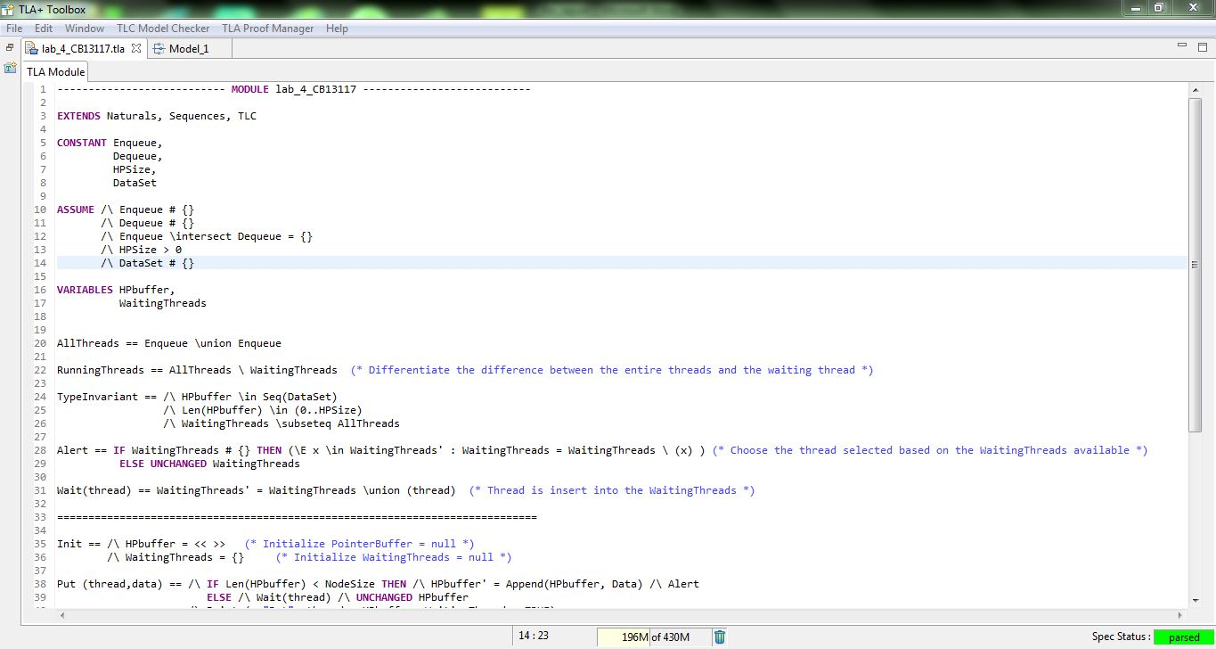
TLA CODING 1

Slide 6
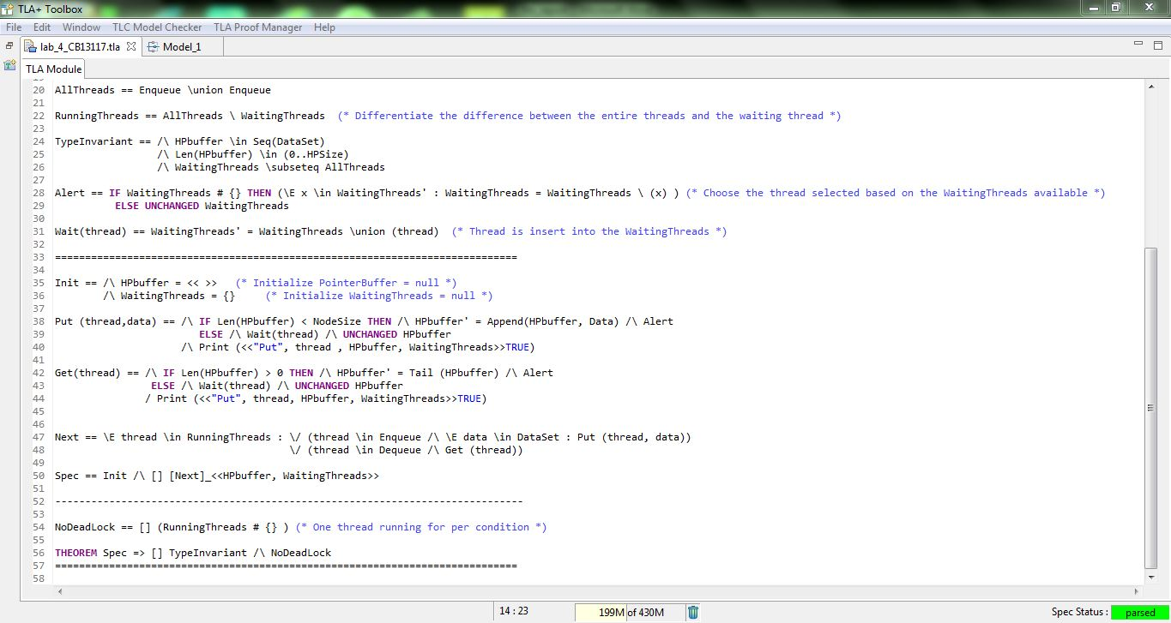
TLA CODING 2

Slide 7
CODING EXPLANATION
There are four constants which are Enqueue, Dequeue, HPSize, and Dataset.
We assume that the variables start from the initial which is null set or empty set.
We need to take note that the HPSize is also non-empty set and there is at least one amount of data can be delivering through the buffer.
After that we declared HPbuffer variable and WaitingThreads variable.
The HPbuffer is a series of data elements while WaitingThreads is a set of threads.
AllThreads is used as the Enqueue threads union with the entire Dequeue threads and Running Threads is utilize as a set of difference between all the threads and the ongoing running threads.
For the Alert, it is being used as to choose the thread within the WaitingThreads set, if the process need to be continue, else it will remain unchanged for the WaitingThreads..

Slide 8
CODING EXPLANATION (CONTINUED)
Wait process is defined as suspension of the thread and allocate into the WaitingThreads.
Init is being used to execute the HPbuffer as empty sets of order and at the same time the WaitingThreads as an empty set.
The Method of “Get” suspends the calling thread until the buffer is already “non-empty”. The thread then deletes one object from the HPbuffer and make and “Alert” to unlock the thread block on Wait order.
“Alert” is used whenever the HPbuffer experience modification.
In order to suspend “Wait” is being used.
“Next” is used for system changeover to its next state.
NoDeadLock is defined as there is at least one thread running and fulfill the NoDeadLock characteristic.

Slide 9
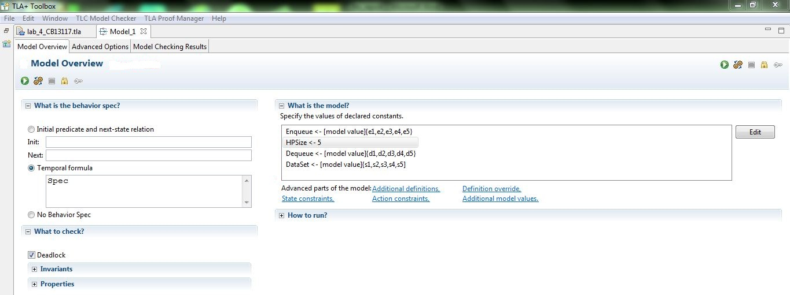
TLA MODEL OVERVIEW

Slide 10
MODEL OVERVIEW EXPLANATON
We need to initialize the value in the Enqueue, HPSize, Dequeue, and Dataset before checking is being made.
We using HPSize -> 5 for our data initiation during th model checking process. The result shown in the “MODEL CHECKING RESULT” diagram.

Slide 11
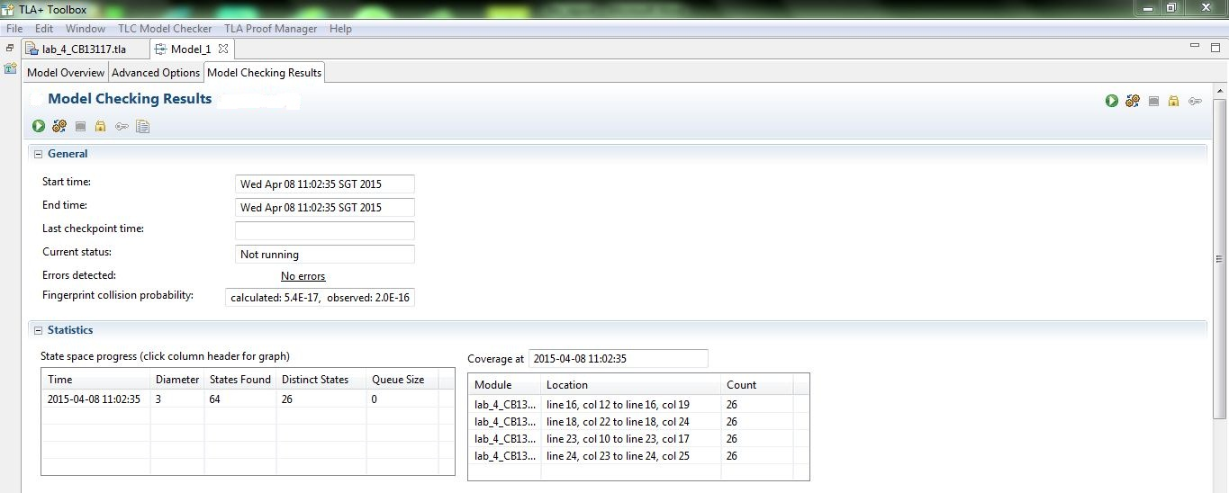
MODEL CHECKING RESULT

Slide 12

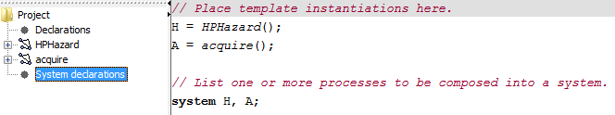
UPPAAL
Hazard Pointer Declaration

Slide 13
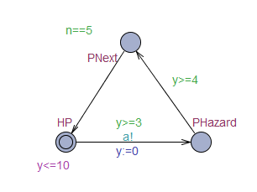
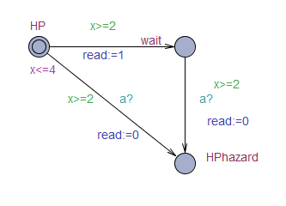
Hazard Pointer Diagram
HPHazard acquire
Figure above shows Hazard Pointer which is involve two templates. First one called HPHazard used to run the basic flow and for the second one called acquire used to check and process if there is reader or not at that time.

Slide 14
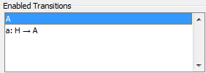
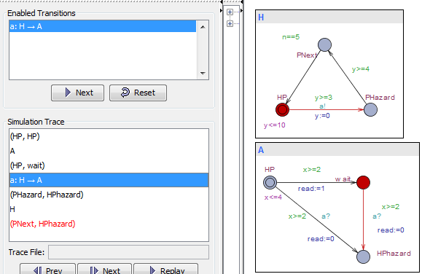
There is two enable transitions that can be apply while running this tools.
Figure above shows the transaction between HP ->wait->HPhazard and PHazard->PNext. These flows occur if
there is at least one reader still reading and have to wait
before delete it.

Slide 15
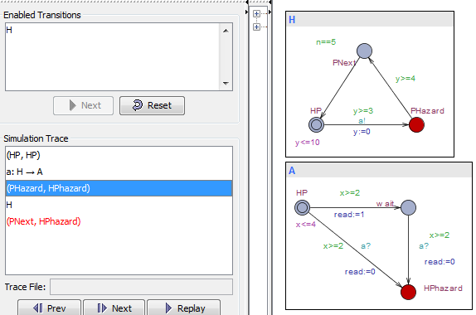
In other transaction, these flows occur when there is no reader still reading and the flow is HP->HPhazard->PNext. It just skips the node waiting and the book can be release without affect anything.

Slide 16
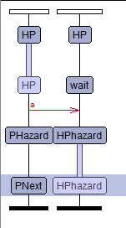
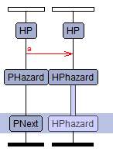
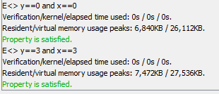
Figure above shows the verifier that had been test. It was satisfied when x and y are equal to 3 or equal to 0. This is follow the rule in HPHazard allowing x<=4 and y<=10.
Read>=1
Read=0

Slide 17
CONCLUSION
We had gained more experiences, important of TLA and Uppal languages and moral values too.
At the same time we also had a great chance to know well about the important of the subject Formal Methods for computer students.
Allows us to improve our knowledge in computer programmed development.
We also learned some vital value of system such as the accuracy, correctness, robustness of the problem using a specific specification.
We also had experiences on the memory which allows to used by consumed nodes to be reclaimed by the OS.
Hazard pointers only require basic a basic CAS or LL/SC instruction.

